Slide 1
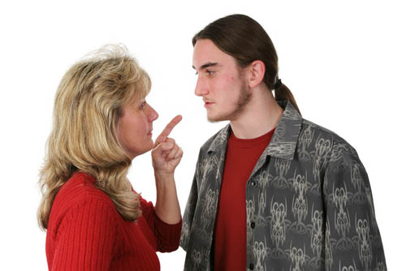
7-12 GIVING INSTRUCTIONS: IMPERATIVE SENTENCES
Listen to me!

Slide 2
7-12 GIVING INSTRUCTIONS: IMPERATIVE SENTENCES
COMMAND
Sit down! You are in trouble.
Yes, Mom.
(a)

Slide 3
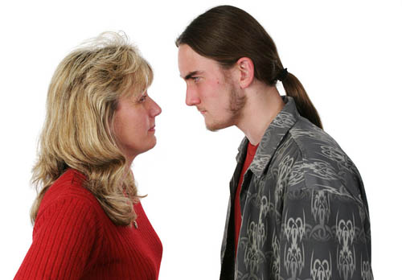
7-12 GIVING INSTRUCTIONS: IMPERATIVE SENTENCES
REQUEST
Sit down,
please. I want to talk to you.
Okay, Mom.
(b)

Slide 4

7-12 GIVING INSTRUCTIONS: IMPERATIVE SENTENCES
DIRECTIONS
(c)
Emma: So, where should I turn?
Adam: In two miles, turn right.
Then drive five miles to the
hotel on the left.

Slide 5
7-12 GIVING INSTRUCTIONS: IMPERATIVE SENTENCES
COMMAND
REQUEST
DIRECTIONS
(a) Sit down!
(b) Sit down, please.
(c) Turn right. Then drive five miles.
give commands
make polite requests
give directions
imperative
sentences

Slide 6
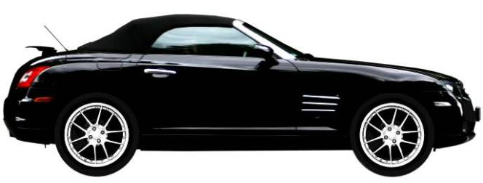
7-12 GIVING INSTRUCTIONS: IMPERATIVE SENTENCES
(d) Slow down!

Slide 7
7-12 GIVING INSTRUCTIONS: IMPERATIVE SENTENCES
(d) Slow down!
(e) Please slow down!

Slide 8
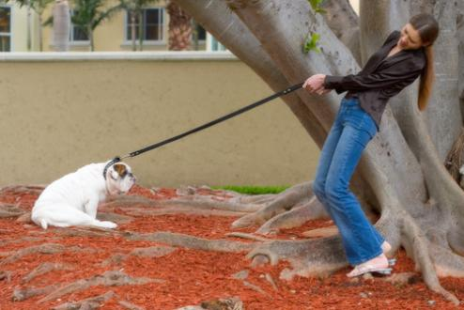
7-12 GIVING INSTRUCTIONS: IMPERATIVE SENTENCES
(d) Slow down!
(e) Please slow down!
(f) Come on!
(f) Come on!
subject of sentence = you (unspoken)

Slide 9
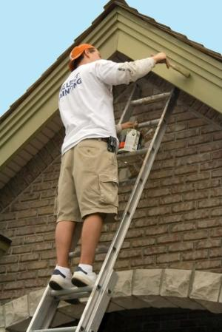
7-12 GIVING INSTRUCTIONS: IMPERATIVE SENTENCES
(g) Don’t worry. I won’t fall.

Slide 10
7-12 GIVING INSTRUCTIONS: IMPERATIVE SENTENCES
(g) Don’t worry. I won’t fall.
(h) Please don’t drive so fast.

Slide 11
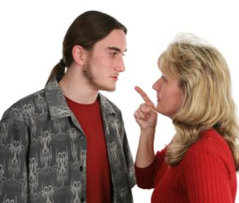
7-12 GIVING INSTRUCTIONS: IMPERATIVE SENTENCES
(g) Don’t worry. I won’t fall.
(h) Please don’t drive so fast.
(i) Don’t do that again.
Don’t + simple form of a verb

Slide 12

7-12 LET’S PRACTICE
command
request
directions
?
Please don’t worry about me.

Slide 13
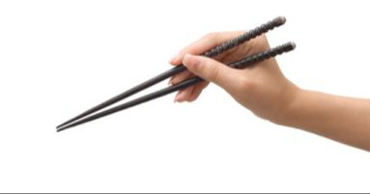
7-12 LET’S PRACTICE
command
request
directions
?
To use chopsticks, keep one finger over
the other, and use your thumb to direct the movement.

Slide 14
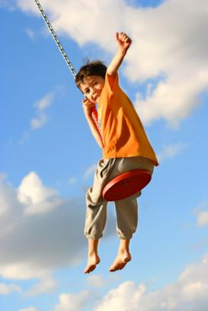
7-12 LET’S PRACTICE
command
request
directions
?
Don’t swing so high!

